Slide 1
Regression Analysis
Poisson Regression
Nicoleta Serban, Ph.D.
Professor
Stewart School of Industrial and Systems Engineering
Statistical Inference: Data Example

Slide 2

About This Lesson

Slide 3
Data Example 1: High School Awards
Objective: To model and predict the number of awards earned by students at one high school for multiple high schools.
Response Variable: The number of awards earned by students at a high school per year
Predicting Variables:
The type of program in which the student was enrolled, with three levels: 1 = "General", 2 = "Academic" and 3 ="Vocational"; and
The score on the final exam in math.
Acknowledgement: This data example was acquired from the Institute for Digital Research and Education at University of California, Los Angeles.

Slide 4
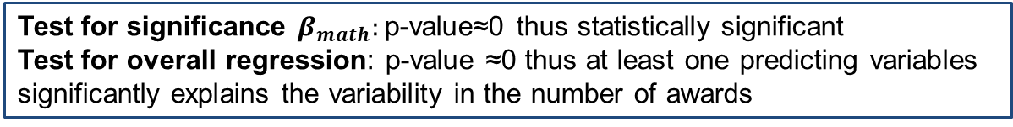
Data Example 1: Statistical Inference
m1 = glm(num_awards ~ prog + math, family="poisson", data=awardsdata)
summary(m1)
Null deviance: 287.67 on 199 degrees of freedom
Residual deviance: 189.45 on 196 degrees of freedom
1-pchisq((287.67-189.45),(199-196))
[1] 0
 | Estimate | Std. Error | z value | Pr(>|z|)
(Intercept) | -5.24712 | 0.65845 | -7.969 | 1.60e-15 ***
progAcademic | 1.08386 | 0.35825 | 3.025 | 0.00248 **
progVocational | 0.36981 | 0.44107 | 0.838 | 0.40179
math | 0.07015 | 0.01060 | 6.619 | 3.63e-11 ***
Test for significance $β_{math}:$p-value≈0 thus statistically significant
Test for overall regression: p-value ≈0 thus at least one predicting variables significantly explains the variability in the number of awards

Slide 5
Data Example 2: Insurance Claims
Objective: To explain factors that are associated to car insurance claims due to accidents or other events leading to car damage.
Response Variable: The number of car insurance claims per policyholder:
Holders: numbers of policyholders; and
Claims: numbers of claims
Predicting Variables:
District of residence of policyholder (1 to 4): 4 is major cities.
Classification of cars with levels <1 litre, 1–1.5 litre, 1.5–2 litre, >2 litre.
Age group of the policyholder: <25, 25–29, 30–35, >35.

Slide 6
Data Example 2: Statistical Inference
m.ins = glm(Claims ~ District + Group + Age + offset(log(Holders)),
data = Insurance, family = poisson)
summary(m.ins)
Coefficients:
Null deviance: 236.26 on 63 degrees of freedom
Residual deviance: 51.42 on 54 degrees of freedom
 | Estimate | Std. Error | z value | Pr(>|z|)
(Intercept) | -1.810508 | 0.032972 | -54.910 | < 2e-16 ***
……….
Age.L | -0.394432 | 0.049404 | -7.984 | 1.42e-15 ***
Age.Q | -0.000355 | 0.048918 | -0.007 | 0.994210
Age.C | -0.016737 | 0.048478 | -0.345 | 0.729910
What are these Age variables?

Slide 7
Data Example 2: Statistical Inference
library(MASS)
summary(Insurance)
Ins.dat = within(Insurance, {
Age = factor(Age, ordered = F)
Group = factor(Group, ordered = F)
District = factor(District, ordered = F)})
m.ins = glm(Claims ~ District + Group + Age + offset(log(Holders)), data = Ins.dat, family = poisson)
summary(m.ins)

Slide 8
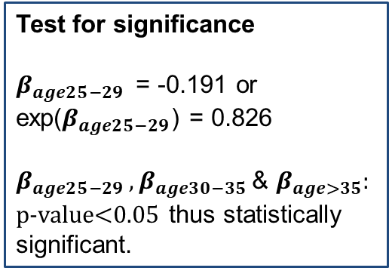
Data Example 2: Statistical Inference
m.ins = glm(Claims ~ District + Group + Age + offset(log(Holders)),
data = Ins.dat, family = poisson)
summary(m.ins)
Coefficients:
Null deviance: 236.26 on 63 degrees of freedom
Residual deviance: 51.42 on 54 degrees of freedom
Test for significance
$β_{age25−29 }$ = -0.191 or exp($β_{age25−29}$) = 0.826
${β_{age25−29 },β}_{age30−35 }$& $β_{age>35}:$
p-value<0.05 thus statistically significant.
 | Estimate | Std. Error | z value | Pr(>|z|)
(Intercept) | -1.82174 | 0.07679 | -23.724 | < 2e-16 ***
……….
Age25-29 | -0.19101 | 0.08286 | -2.305 | 0.021149 *
Age30-35 | -0.34495 | 0.08137 | -4.239 | 2.24e-05 ***
Age>35 | -0.53667 | 0.06996 | -7.672 | 1.70e-04 ***

Slide 9
Data Example 2: Statistical Inference (cont’d)
m.ins = glm(Claims ~ District + Group + Age + offset(log(Holders)),
data = Ins.dat, family = poisson)
summary(m.ins)
# test for overall regression
1-pchisq((236.26-51.42),(63-54)
Test for overall regression: p-value ≈0 thus at least one predicting variables significantly explains the variability in the number of claims

Slide 10
Data Example 2: Statistical Inference (cont’d)
# Is the district of residence of policyholder a statistically significant variable given all other predicting variables in the model?
Full model: District + Group + Age
Reduced model: Group + Age
library(aod)
wald.test(b=coef(m.ins), Sigma=vcov(m.ins), Terms=2:4)
Wald test:
----------
Chi-squared test:
X2 = 14.6, df = 3, P(> X2) = 0.0022
Test for subsets of coefficients: p-value =0.002 reject the null hypothesis and conclude that the District variable does have significant explanatory power

Slide 11

Summary

